Slide 1
Usability Evaluation in Selecting Educational Technology
Sonja Dimitrijević* & Vladan Devedžić**
*Mihailo Pupin Institute, Belgrade, Serbia, **Faculty of Organizational Sciences, Belgrade, Serbia
sonja.dimitrijevic@pupin.rs, devedzic@gmail.com

Slide 2
Agenda
Introduction
Objective
Research Questions
Methodology
Results
Discussion
Conclusion

Slide 3
Introduction
Usability has many definitions and evaluation methods (analytical and empirical).
Pedagogical usability comprises both ‘technical’ and pedagogical attributes.
Usability is an important, yet demanding factor in selection of technology to be used in an educational environment.
Educators/teachers more and more become evaluators and decision makers in the educational technology selection process.
Extensive usability evaluation is demanding and, thus, usually conducted or facilitated by usability experts.
Notes:
“the extent to which a product can be used by specified users to achieve specified goals with effectiveness, efficiency and satisfaction in a specified context of us” (ISO)
usability attributes: learnability, efficiency, memorability, errors and satisfaction (Nielson)
One of the basic classifications of usability evaluation methods includes analytical methods, which are conducted by usability experts (e.g., inspections), and empirical methods, which require participation of real users, thus involve usability testing and inquiry methods (questionnaires and surveys)

Slide 4
Objective
The objective of this systematic review is to examine and analyse how the challenge of usability evaluation is met in learning environments of higher education when (re)considering the use of technology for educational purposes.

Slide 5
Research Questions
RQ1: What methods have been proposed or employed in the context of educational technology selection to evaluate usability?
RQ2: What usability attributes, i.e. criteria, have been proposed or employed in the context of educational technology selection?
RQ3: How have pedagogical criteria been considered in the identified approaches?
RQ4: How has the learner and teacher perspective been considered in the identified approaches?

Slide 6
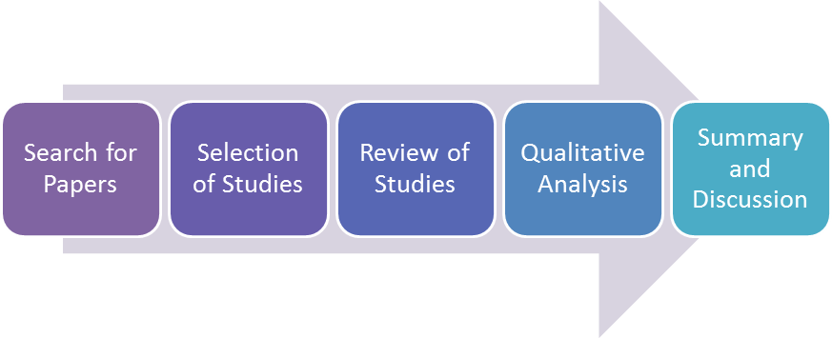
Methodology
SCOPUS, ACM, ISI, IEEE (1178); following up the references (306) and the citations (480)
Facilitated with an online spreadsheet template and visualizations
Based on the defined criteria and quality of papers
Final 45 studies

Slide 7
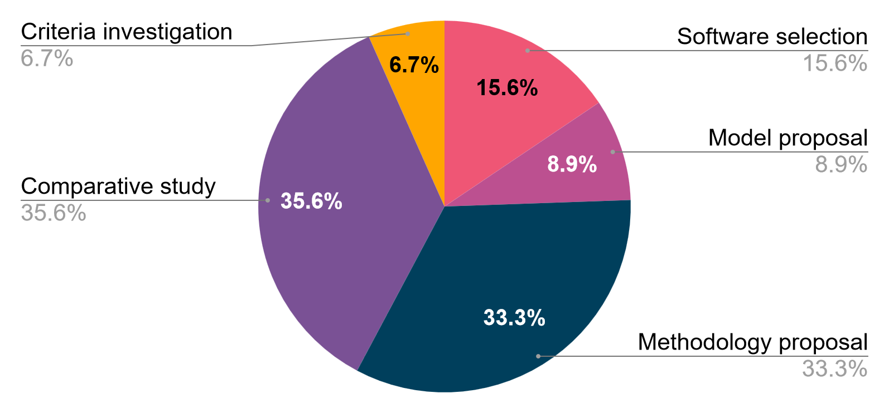
Results - Types of Studies

Slide 8
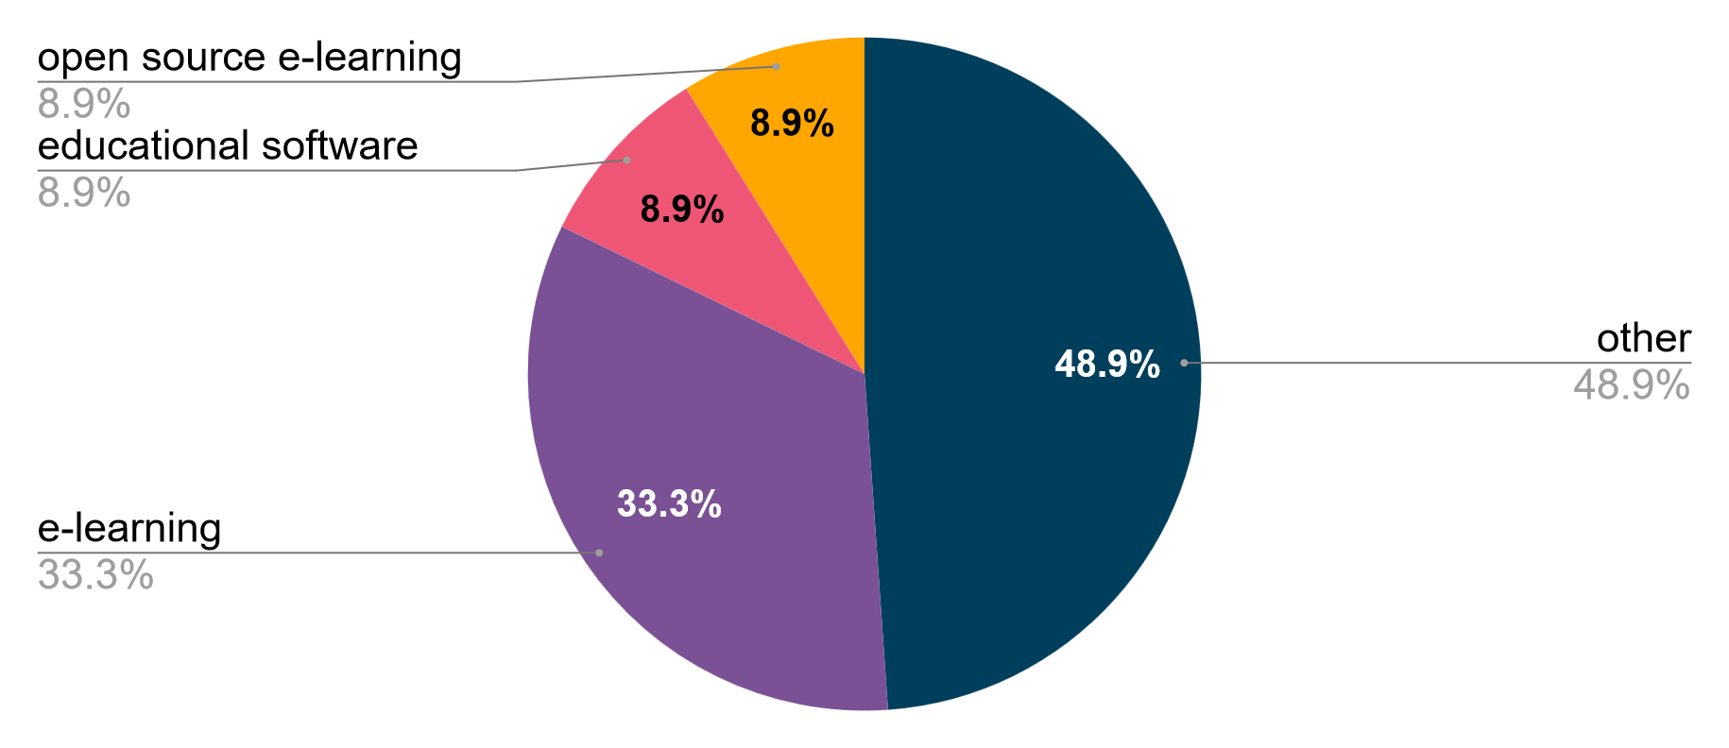
Results - Categories of Educational Technology

Slide 9
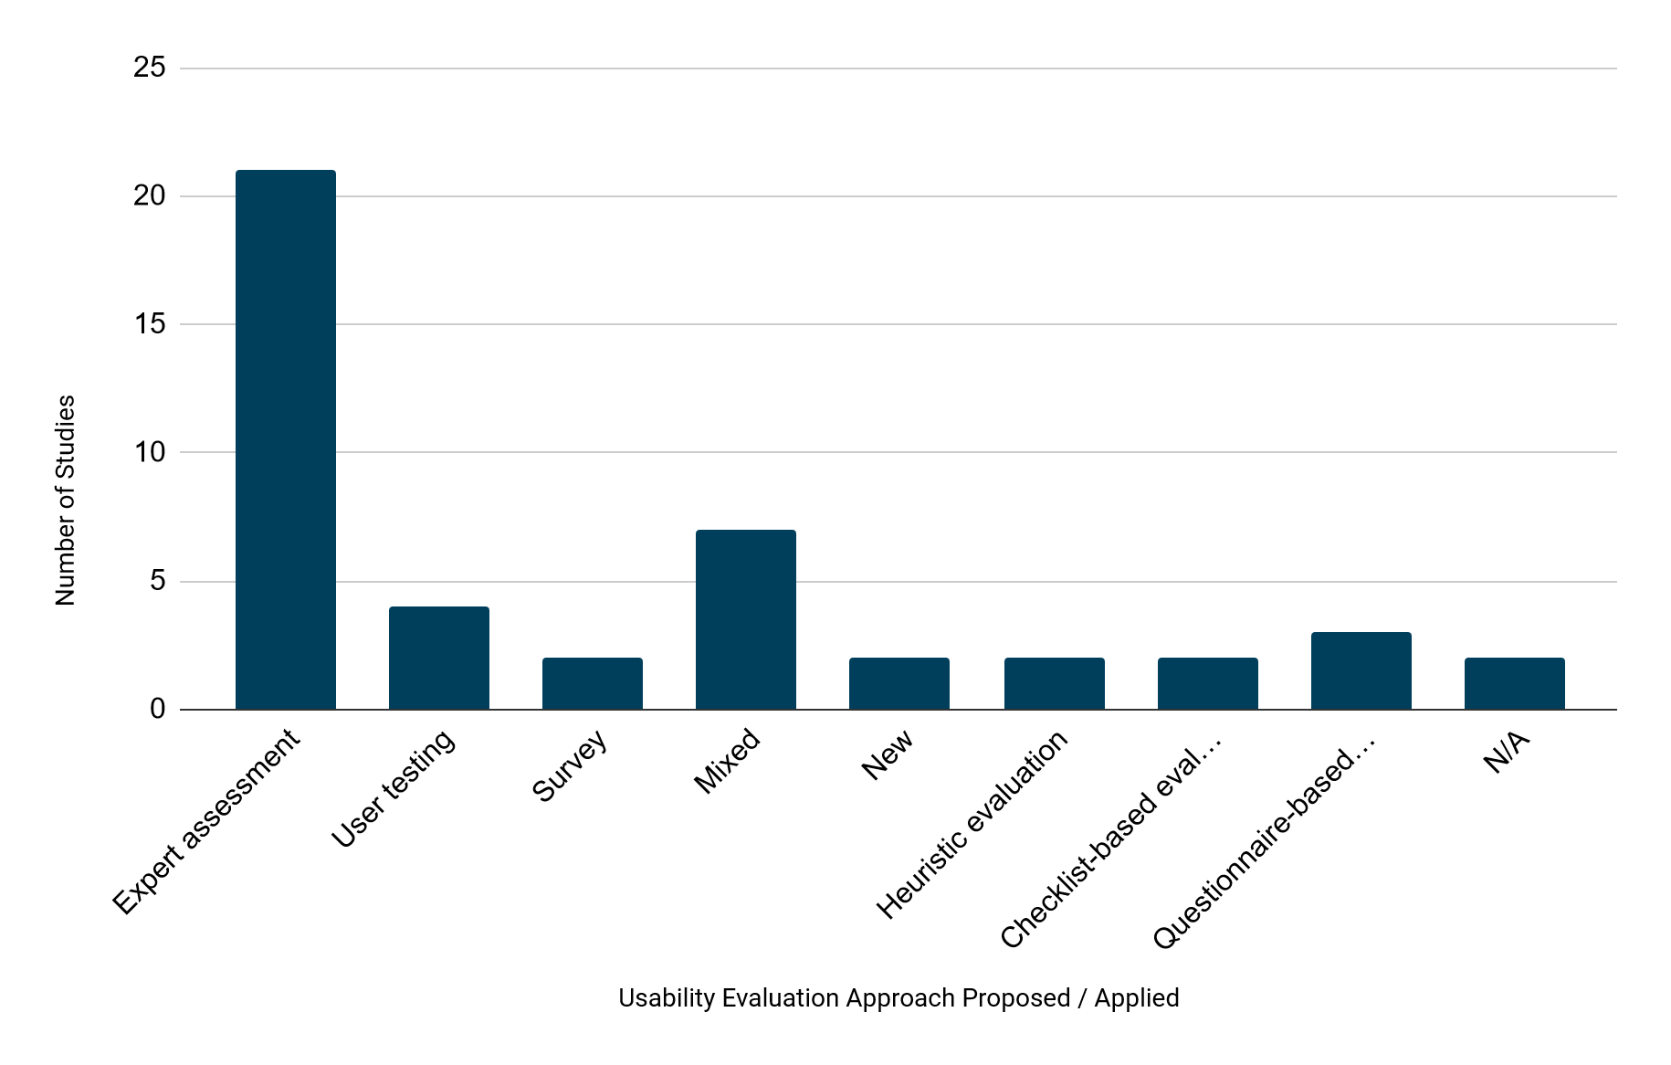
Results - Usability Evaluation Methods

Slide 10
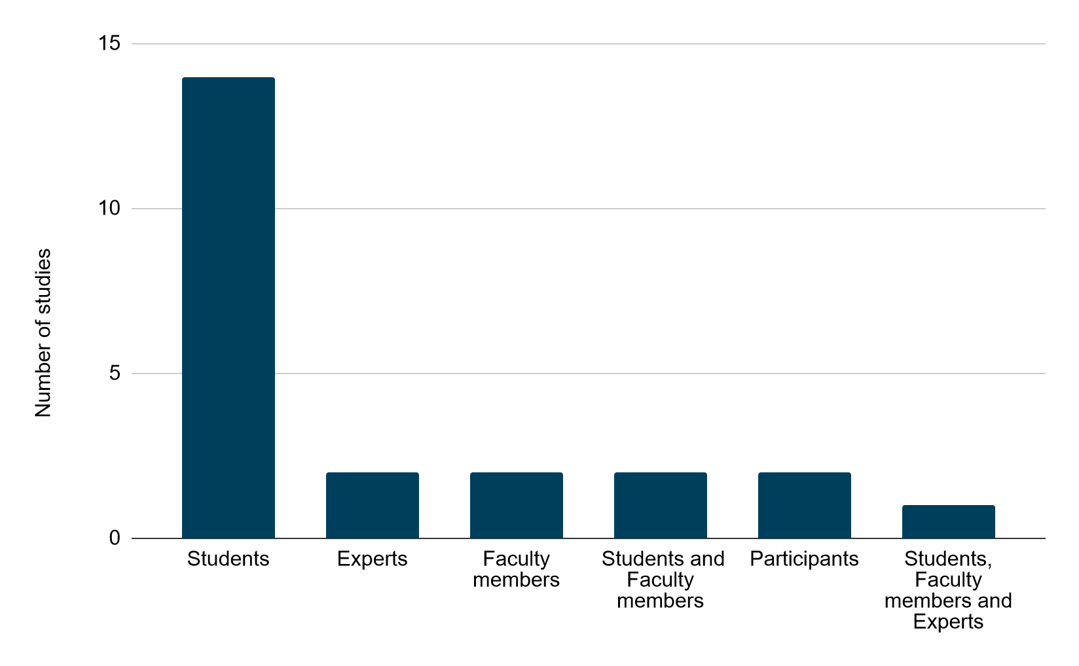
Results - Types of Participants

Slide 11
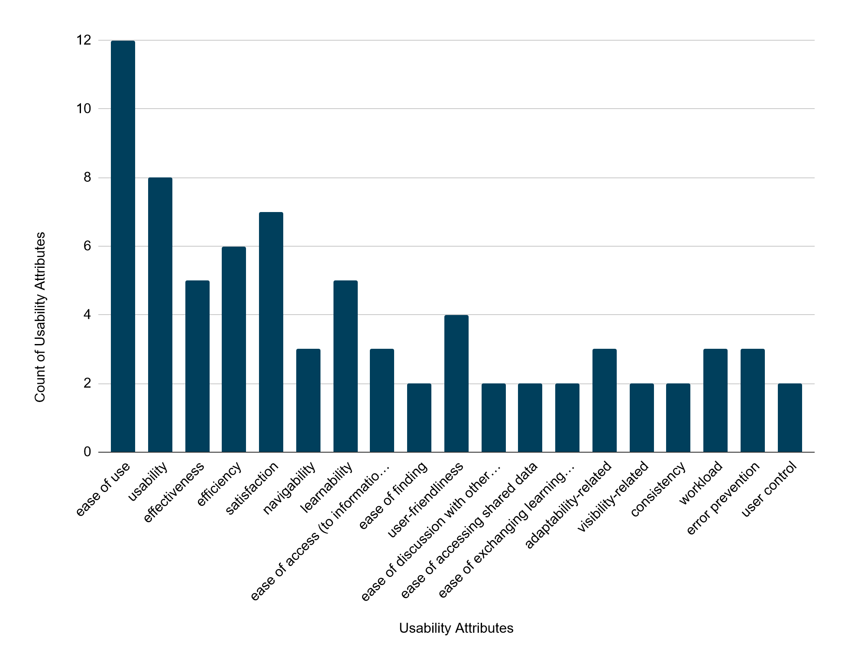
Results - Usability Attributes

Slide 12
Discussion - RQ1
Usability Evaluation Methods Proposed or Employed (RQ1)
The dominant approach is expert assessment including simple qualitative reviews, such as learner or teacher reviews, quantitative assessments, as well as mixed assessments.
Quantitative assessment is easy to conduct and use in multiple criteria decision making approaches, which may explain its prevalence.
When applied, user testing is mostly informal with a small number of participants.
The underuse of more formal usability methods can be explained by limited expertise, experience and resources in learning environments.
There is underuse of inquiry approaches. Yet, its application in the post-implementation phase of the selection process, as well as in field studies with teachers’ and learners’ direct involvement is especially promising.
Notes:
A reason could be a viewpoint that the selection process is over when educational technology is introduced into a learning environment. However, there have been several approaches that oppose this viewpoint.

Slide 13
Discussion - RQ2
Usability Attributes / Criteria Proposed or Employed (RQ2)
Ease of use and ‘perceived’ usability are most frequently applied usability attributes.
Many specializations of ‘ease of use’ (e.g., ease of peer interaction, ease of discussion...) are noted.
The selection of usability attributes is not theoretically corroborated in most cases.
Effectiveness, Efficiency and Satisfaction according to ISO 9241-11 have been applied in few studies.
Usability attributes according to ISO/IEC 25010 (e.g., learnability, operability...) have been applied in only one study.

Slide 14
Discussion - RQ3
Pedagogical Criteria Proposed or Employed (RQ3)
More than a quarter of the studies have explicitly involved pedagogical criteria along with usability criteria.
A considerable number of the studies have marginally addressed pedagogical criteria through consideration of functionality and utility/usefulness of the technology.
Only a couple of approaches have attempted to fully integrate usability and pedagogical usability.
The analyzed studies have mostly failed to address complementarity of these two aspects more profoundly.

Slide 15
Discussion - RQ4
Learner and Teacher Perspective (RQ4)
Learners and educators/teachers have been involved in the selection process in less than half of the studies.
Participation of both students and teachers in usability studies on educational technology is highly advisable.
Most approaches for eliciting the learner/teacher perspective have been based on a single method/practice, which, without questioning the validity, limits their potential.
The joint practices of user testing and inquiry ensure an insight into usability evaluation from two perspectives: objective and subjective.
Although under-applied, inquiry practices could be quite useful for obtaining the learner perspective from a larger number of learners.

Slide 16
Conclusion
There is a clear need for relatively simple and efficient, yet effective enough, usability evaluation approaches that fit well the educational technology selection.
However, effectiveness of many of the reported usability approaches, whether new or existing, is underexplored or disputable, and requires further research.
Nevertheless, there are some promising results worth further investigation.
There is also enough research space for proposals of new approaches, or adapted usability and HCI practices with careful consideration of the educational context.
Notes:
Simple tools that facilitate the evaluation and selection should be considered as a part of some of these proposals. In addition, research in this area would benefit of more focused studies investigating usability attributes and metrics.

Slide 17
Usability Evaluation in Selecting Educational Technology
Sonja Dimitrijević* & Vladan Devedžić**
*Mihailo Pupin Institute, Belgrade, Serbia, **Faculty of Organizational Sciences, Belgrade, Serbia
sonja.dimitrijevic@pupin.rs, devedzic@gmail.com

