Slide 1
School Management Improvement - Pedagogue Information System
Author: Zoltan Kazi
University of Novi Sad
Technical faculty “Mihajlo Pupin”
Zrenjanin, Serbia
International Conference
Information Technology and Education Development, ITRO 2020.

Slide 2
CONTENT
ITRO 2020 School Management Improvement – School Pedagogue Information System
Introduction
Related Work
System Analyses and Design
Implementation
Conclusion

Slide 3
1. INTRODUCTION
ITRO 2020 School Management Improvement – School Pedagogue Information System
Information systems (IS) can be used as a decision support system and for realizing the basic enterprise functions.
Every elementary and high school as a social well-organized system must have an information system supported by information and communication technology (ICT).

Slide 4
1. INTRODUCTION
ITRO 2020 School Management Improvement – School Pedagogue Information System
IS development - a process of transforming concepts from the real world to various models that can be implemented in a form of solution through activities like user requirements specification, future model design, process models, data models, object-oriented models, technical specifications, program specification etc.

Slide 5
2. RELATED WORK
ITRO 2020 School Management Improvement – School Pedagogue Information System
IS enable school authority's better efficiency in education planning, strategical planning, and schools monitoring.
Some related IS:
Education Management Information System (EMIS) developed in Philippines;
Management information system (MIS);
Web-based school information management software;
School information systems is a set of three sub-group of management information systems.

Slide 6
3. SYSTEM ANALYSES AND DESIGN
ITRO 2020 School Management Improvement – School Pedagogue Information System
Information system development is divided into several phases:
Planning (project identification, economic feasibility, workplan, tasks, staff).
Analyses (requirements, model process, data model, use cases).
Design (architecture, interface, program, databases, files).
Implementation (programming, testing, installation, documenting, maintaining).

Slide 7
3. SYSTEM ANALYSES AND DESIGN
ITRO 2020 School Management Improvement – School Pedagogue Information System
Business process
model diagram
with system basic
functions:
school year
preparation,
work during
the school year,
improving plans
and programs.

Slide 8
3. SYSTEM ANALYSES AND DESIGN
ITRO 2020 School Management Improvement – School Pedagogue Information System
List of organized tasks presented as data processes in this model which should be supported in new software:
 | Basic function | Elementary and primitive business process
1 | School year preparation | Recording plans and programs Confirmation of old plans and programs Classification of teaching obligations Opening students’ files Recording test results
2 | Work during the school year | Student data processing Analysis of students work and progress Forming a report to the ministry
3 | Improving plans and programs | Collecting new knowledge documentation and literature Curriculum changes

Slide 9
3. SYSTEM ANALYSES AND DESIGN
ITRO 2020 School Management Improvement – School Pedagogue Information System
Physical data model with its characteristics that correspond to relational database management software
presents an
appearance
of database
after
implementation. :

Slide 10
3. SYSTEM ANALYSES AND DESIGN
ITRO 2020 School Management Improvement – School Pedagogue Information System
Use case diagram – Pedagogue software functions model
for entering
new data:

Slide 11
4. IMPLEMENTATION
ITRO 2020 School Management Improvement – School Pedagogue Information System
Implementation is based on models that are result of the design phase of IS development.
Software was realized in PHP programming language with intensive usage of hypertext markup language (HTML), cascade style sheet (CSS), and JavaScript technologies.
Web application was created as a solution that is often use in the ICT world.
Data models were implemented as a relational database created in MySQL database management system with PhpMyAdmin web application.

Slide 12
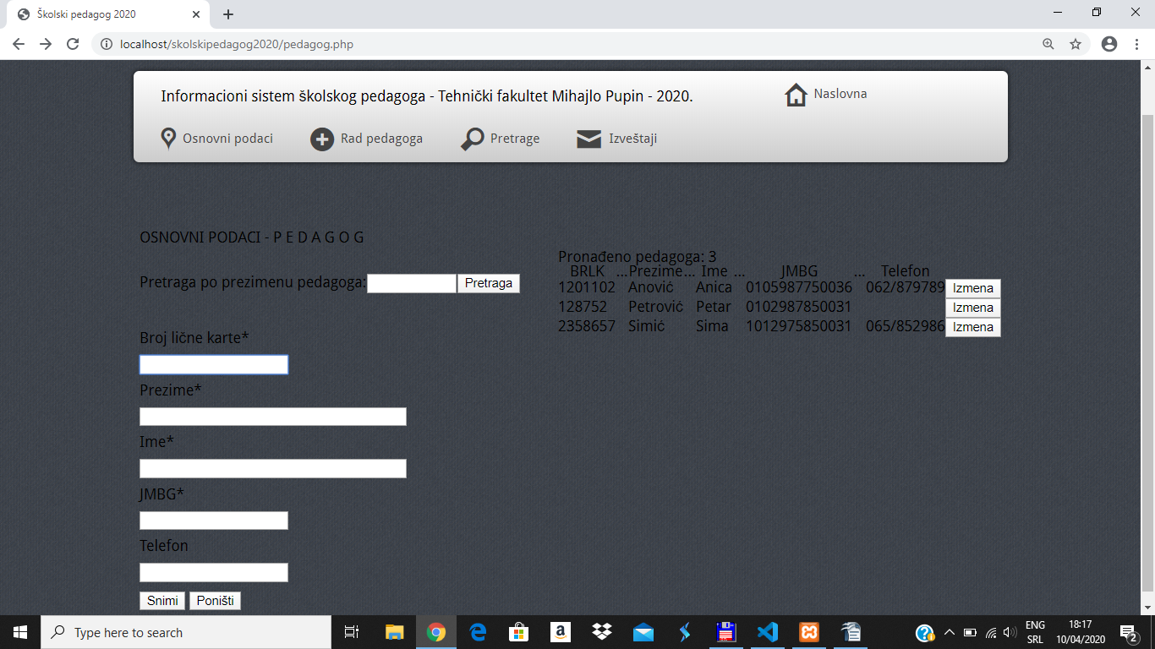
4. IMPLEMENTATION
ITRO 2020 School Management Improvement – School Pedagogue Information System
Web application page for entering data:

Slide 13
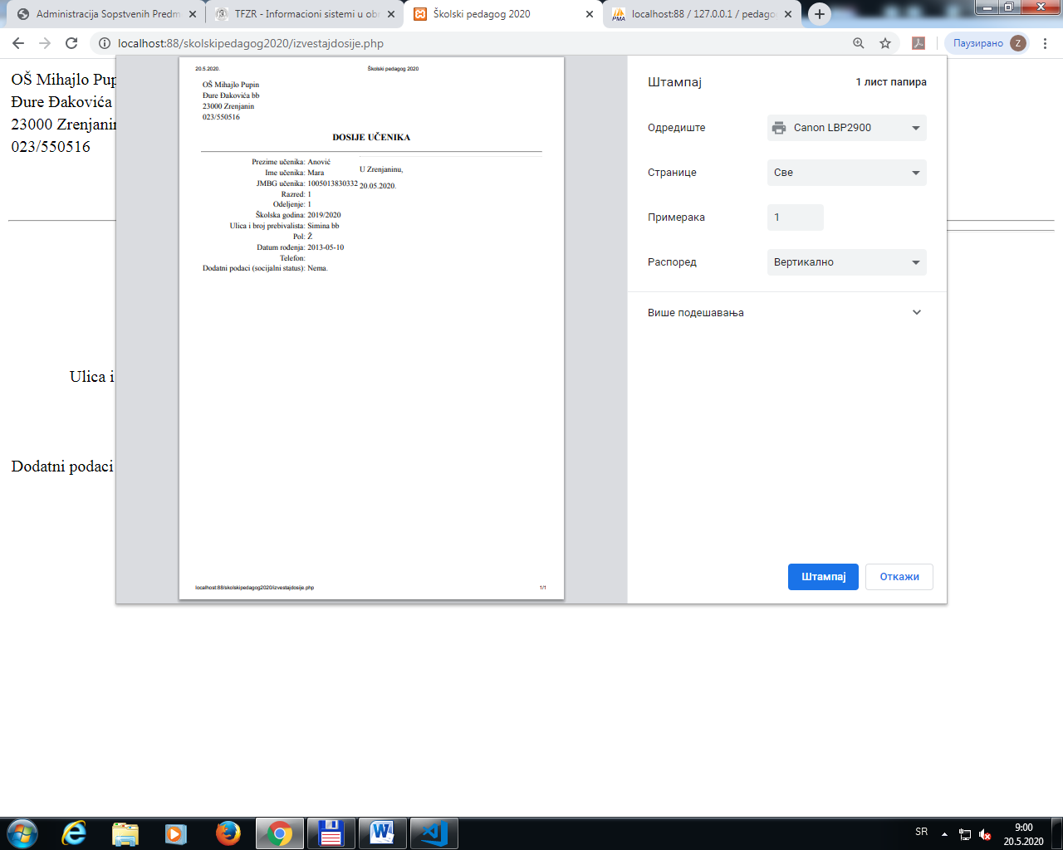
4. IMPLEMENTATION
ITRO 2020 School Management Improvement – School Pedagogue Information System
Report generated in IS web application:

Slide 14
5. CONCLUSION
ITRO 2020 School Management Improvement – School Pedagogue Information System
Pedagogue IS could be used to improve the school management work because it is suitable for planning, monitoring and evaluation of school operations.
It was developed as a teaching example at University of Novi Sad, at Technical faculty “Mihajlo Pupin” in Zrenjanin.

Slide 15
5. CONCLUSION
ITRO 2020 School Management Improvement – School Pedagogue Information System
Further system development could include programming the mobile version of application for Android and IoS operating systems.
Upgrading function could be multiuser function with authentication and login form at the beginning, so two or more pedagogues or other users could use this information system.

