Slide 1
Examining attendance, performance and interest in a CS course in relation to students’ achievement goal orientation and self-evaluation
Bojan Tomić, Nikola Milikić, Jelena Jovanović, Vladan Devedžić
Fakultet organizacionih nauka, Univerzitet u Beogradu
Faculty of organizational sciences, University of Belgrade

Slide 2
Introduction
High market need for programmers
High failure and dropout rates for CS courses
“Not everyone can be a good programmer”
Problem:
predicting CS course performance and interest
Input variables (usually):
Motivation (MSLQ, AGO...), learning strategies, self-efficacy, gender...

Slide 3
Achievement goal orientation – AGO
Achievement goals - motivation
Broad categories of learners' aims/targets/purposes in evaluative learning settings
Example – learning and mastery of a task for its own sake OR learning to demonstrate performance when compared to others
Several AGO frameworks ([4] is used in this research)
2x2 (Elliot & McGreggor, 2001)[3]
3x2 (Elliot, Murayama & Pekrun, 2011)[4]
“Modified” 3x2 (Shell & Soh, 2013)[12]

Slide 4
AGO 3x2 framework [4]
Valence |  | Goal
 | Task | Self | Others
Positive valence (approach) | Task-approach (focused on the attainment of task-based competence, e.g. “Do the task correctly”) | Self-approach (focused on the attainment of self- based competence, e.g. “Do better than [I did] before”) | Other-approach (focused on the attainment of other-based competence, e.g. “Do better than others”)
Negative valence (avoidance) | Task-avoidance (focused on the avoidance of task-based incompetence, e.g. “Avoid doing the task incorrectly”) | Self-avoidance (focused on the avoidance of self-based incompetence, e.g. “Avoid doing worse than [I did]before”) | Other-avoidance (focused on the avoidance of other-based incompetence, e.g. “Avoid doing worse than others”)

Slide 5
Research objectives
Explore:
students’ motivation (AGO 3x2 framework)
Interest in CS
self-evaluation (on pre-faculty programming knowledge)
Course outcomes: attendance, performance (mid-term test score and final test score)
Explore the relations between:
AGO → attendance, interest, performance
self-evaluation → attendance, interest, performance
Attendance, interest →performance

Slide 6
Educational and research setting
Introductory course on OO programming (Java)
2nd year BS studies, winter semester 2019/2020
215 students – 130 female, 85 male
Semester – 13 weeks (1.5hr labs + 1,5hr lectures per week)
Questionnaire (5th week)
Mid-term test (6th week) – 35 points
Final test (end of semester, several terms) – 65 points
Attendance and performance data summarization at the end of school year

Slide 7
Questionnaire
General data (name, surname, gender)
18 AGO related questions (3x2 AGO questionnaire [4]):
Example (task-approach): “My goal is to get a lot of questions right on the exams in this class.”
Answers on a 1-7 scale (1 being “Totally disagree,” 3 - “Not sure,” and 7 - “Totally agree”)
2 Self-evaluation questions:
Qualitative description on pre-faculty programming experience
Self-evaluation score on a 1-5 scale (5 being highest)

Slide 8
Questionnaire
10 Interest questions
Example: “I think what we are learning in this class is interesting”
Answers on a 1-7 scale (1 being “Totally disagree,” 3 - “Not sure,” and 7 - “Totally agree”)
One inverted question: “This class has been a waste of my time”

Slide 9
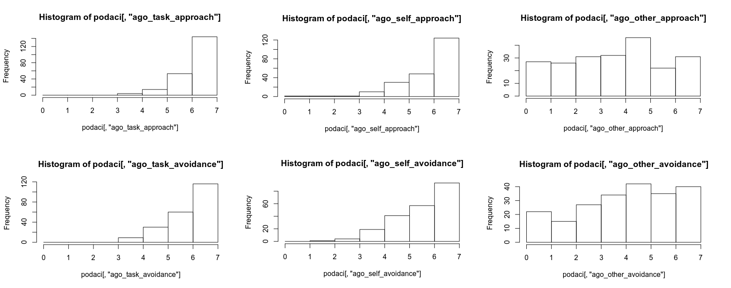
Students’ AGO scores
TASK SELF OTHER
APPROACH
AVOIDANCE

Slide 10
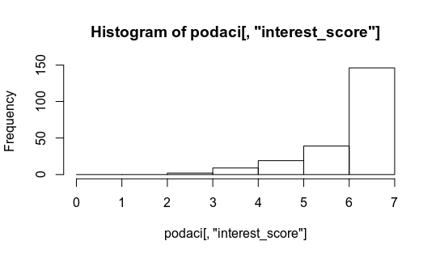
Students’ interest score

Slide 11
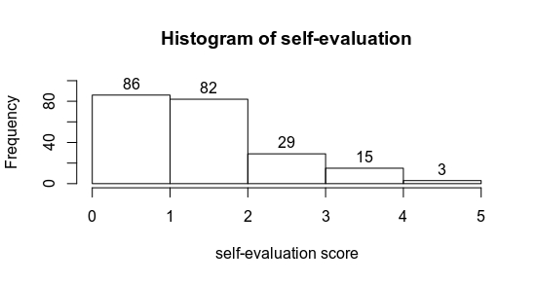
Students’ self-evaluation scores

Slide 12
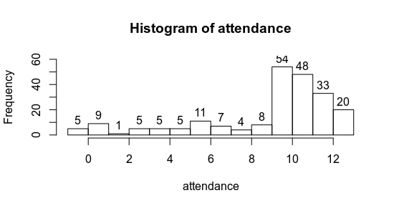
Students’ attendance

Slide 13
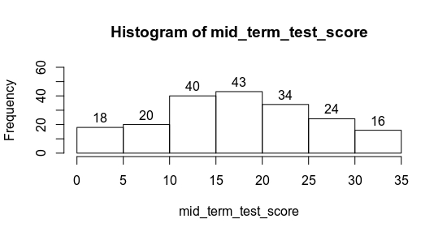
Students’ mid-term test scores

Slide 14
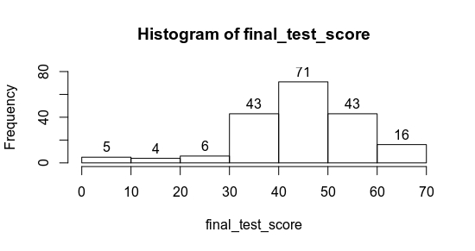
Students’ final test scores

Slide 15
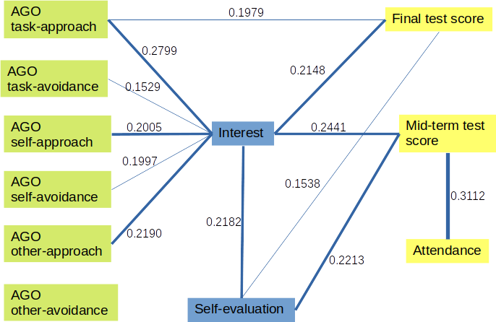
Correlations

Slide 16
Conclusions
Students were:
highly motivated to do their tasks well, improve their knowledge and do better than they did before.
highly motivated to avoid doing worse than (they did) before, both generally and with regards to course tasks.
moderately motivated to outperform their peers, but wanted to avoid under-performing their peers slightly more.
Interest in CS was positively correlated with performance (both mid-term and final test).

Slide 17
Conclusions
Self-evaluation scores were positively correlated with performance (mid-term and final test scores) and interest
Only AGO task-approach was positively correlated with performance (just the final test score)
All AGO constructs except for other-avoidance had a weak positive correlation with interest
Attendance was high (possibly due to course policy), and was correlated only with the mid-term test score.

Slide 18
Thank you for your attention
Questions?

