Slide 1
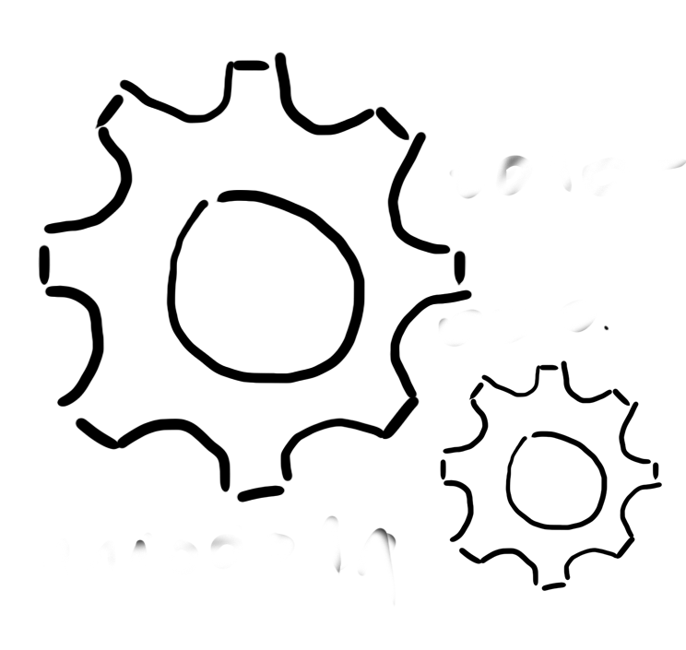



Software Reengineering with Object-Oriented n-Tier Architecture: Case of Desktop-to-Web Transformation
ITRO CONFERENCE
Aleksandra Stojkov, sahskica.s@gmail.com
Ljubica Kazi, ljubica.kazi@gmail.com
Marko Blažić markoblazic93@gmail.com
UNIVERSITY OF NOVI SAD
TECHNICAL FACULTY
“MIHAJLO PUPIN”
ZRENJANIN

Slide 2

ABSTRACT:
This paper presents the problem of software reengineering based on object – oriented principles and the use of web services. The theoretical part describes the concept of object-oriented programming which provides such that application architecture that it can be later expanded, maintained, or modified without changing the core of the application. Prototype of application, built on the principles of object - oriented programming, was reengineered in terms of switching from one platform to another.

Slide 3




Subject of research
Subject of research are the possibilities of applying the basic principles of object-oriented programming, SOLID principles, web services when creating a new version
of software.
The focus is on the transition from
one platform to another of the same technology while preserving the functional core of the application.
desktop application -> web application
H: It is possible to build software by applying object-oriented principles, which will preserve the functional core of the application by moving to a new platform.
HYPOTHESIS

Slide 4
Theoretical background
    OOP is programming model based on object concepts which are used in real life.
  Object-oriented programing
Abstraction
Encapsulation
Inheritance
Polymorphism
    Reverse engineering
    Restructuring / refactorin
    Forward engineering
Single Responsibility Principle
Open/closed principles
The Liskov Substitution Principle
Interface segregation principle
Dependency Inversion Principle
OOP principles
  Software Reengineering
SOLID principles

Slide 5
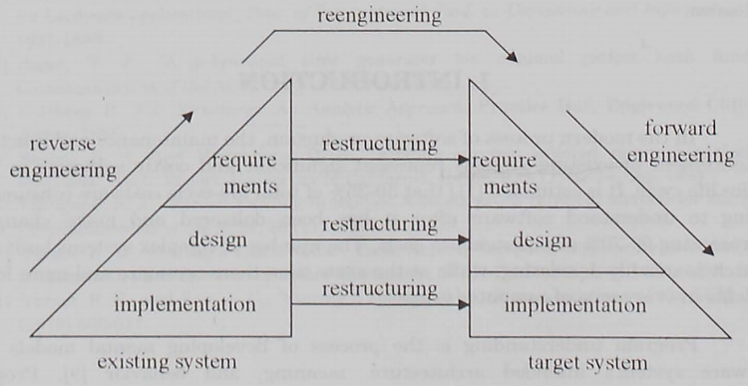
Software reengineering

Slide 6
Examples of software reengineering
    ROSE project - NASA/Johnson Space center
Legacy sistems
    Microsoft Graph - Microsoft

Slide 7
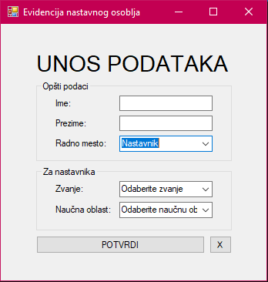
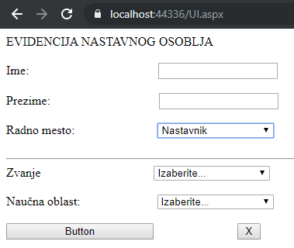
Implemented solution
The aim of the practical part of this paper is to show the application of object - oriented principles in creating software for later reengineering in order to move from one platform to another with the change of technologies for creating user interfaces (desktop and web).
The tools / development environments used to implement the examples are: MS SQL Management Studio and MS SQL Server, Visual Studio 2019, as well as Power Designer
The programming languages ​​used were SQL for database creation, C # for application creation, and UML for model creation.

Slide 8
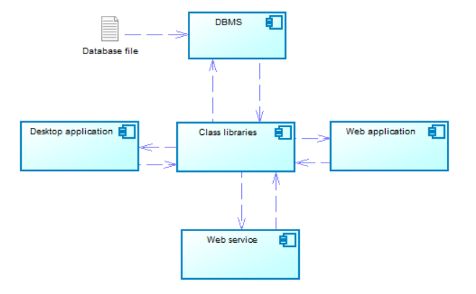
MODELS
    Business process model
    Component diagram
    Use case model

Slide 9
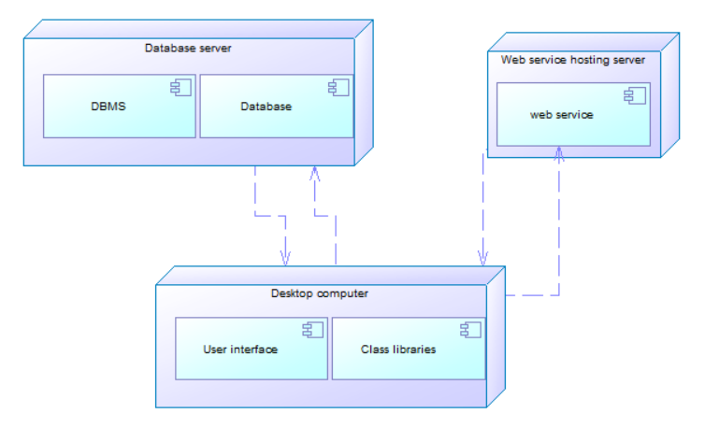
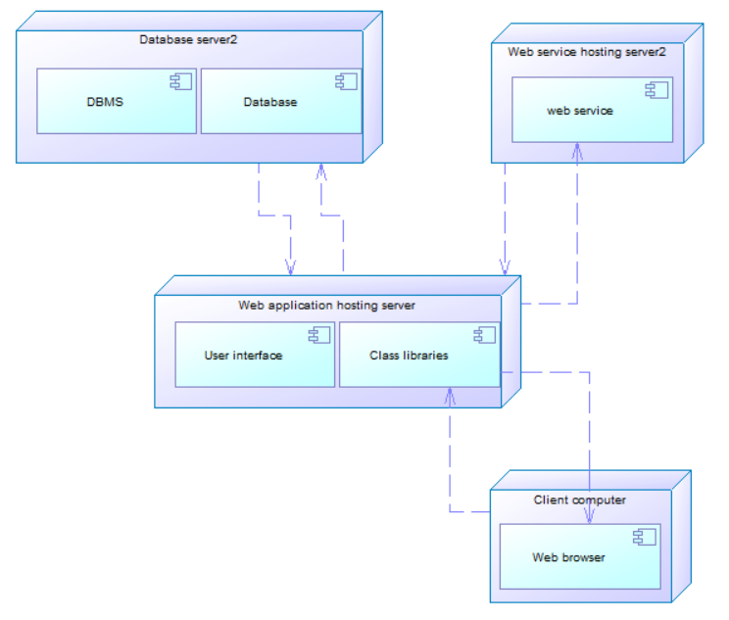
MODELS
Deployment diagram of a desktop application that uses a web service
Deployment diagram of a web application that communicates with a web service

Slide 10
Conclusion
Aim of this research is to explore the role of object-oriented programming principles in efficiency of reengineering. During the theoretical research and related work analysis, it has been proved that object-oriented programming and use of SOLID principles, as well as n-tier architecture helps in more efficient software reengineering. Therefore, hypothesis was proved. Another proof for hypothesis has been obtained with the implemented practical example – case study.

