Slide 1
Correlation between school success and students’ digital competencies
UNIVERSITY OF NOVI SAD
TECHNICAL FACULTY “MIHAJLO PUPIN” ZRENJANIN
Belegisan, D. Glusac and
D. Milanov

Slide 2
Abstract
At the beginning of the 21st century, the European Framework for Key Competences was established, which should be developed by the end of compulsory schooling and represent the basis for further learning as part of lifelong learning. Among the key competencies is the digital competence, which includes independent and critical use of information and communication technologies for work, leisure and communication. This work refers to the connection between students' digital literacy and students' school success, i.e. it shows that students with a higher level of digital literacy have better success in school. The research was conducted among final year high school students in schools in Vojvodina. The obtained results show that there is a correlation between students' digital literacy and the achieved school success. This suggests the need for students' digital competencies to be developed not only in computer science classes, but also the teachers of other subjects should be involved in the process of developing students' digital competencies

Slide 3
Student competencies
A Key competencies for lifelong learning
Communication in the native language that includes the ability to express and interpret concepts, thoughts, feelings, facts and opinions orally or in writing,
Communication in a foreign language that includes the ability to express and interpret concepts, thoughts, feelings, facts and opinions orally or in writing, including mediation skills by summarizing, interpreting, translating, paraphrasing and otherwise, as well as intercultural understanding,
Mathematical, scientific and technological competencies that include basic numerical reasoning, understanding of the world of nature, as well as the ability to apply knowledge and technology for human needs (e.g. medicine, communications, transport...)
Digital competence that includes confident and critical use of information and communication technologies for work, rest and communication

Slide 4
Student competencies
A Key competencies for lifelong learning
Learning how to learn which represents the ability to effectively manage one's own learning with the aim of planning, managing time and information, as well as the ability to overcome obstacles in order to learn successfully using previously acquired knowledge and skills and their application in different situations, individually and / or in the group,
Social and civic competencies that represent the ability to participate effectively and constructively in social and working life and engage in active and democratic participation in diverse communities,
Sense of initiative and entrepreneurship that develops the ability to turn ideas into action through creativity, innovation and risk-taking, as well as the ability to plan and manage projects,
Cultural awareness and expression that includes developing the ability to understand the meaning of creative ideas, experiences and emotions in various media such as music, dance, literature, fine arts and others

Slide 5
Student competencies
B General interdisciplinary competencies
Communication in the native language that includes the ability to express and interpret concepts, thoughts, feelings, facts and opinions orally or in writing,
Communication in a foreign language that includes the ability to express and interpret concepts, thoughts, feelings, facts and opinions orally or in writing, including mediation skills by summarizing, interpreting, translating, paraphrasing and otherwise, as well as intercultural understanding,
Mathematical, scientific and technological competencies that include basic numerical reasoning, understanding of the world of nature, as well as the ability to apply knowledge and technology for human needs (e.g. medicine, communications, transport...)
Digital competence that includes confident and critical use of information and communication technologies for work, rest and communication

Slide 6
Student competencies
C Digital competence (digital literacy)
digital competence,
use of digital competence,
digital transformation

Slide 7
Student competencies
B General interdisciplinary competencies
1. Learning competence
2. Responsible participation in a democratic society
3. Aesthetic competence
4. Communication
5. Responsible attitude towards the environment
6. Responsible attitude towards health
7. Entrepreneurship and orientation towards entrepreneurship
8. Working with data and information
9. Troubleshooting
10. Cooperation
11. Digital competence

Slide 8
Research
The goal of the research is to determine whether there is a statistically significant correlation between school success and students' digital competencies and whether there are differences in students' school success according to gender criteria
Hypothesis
H1: Students who have developed digital competencies achieve better success in school.
The derived hypotheses are:
H1.1 There is a linear correlation between students' digital competencies and student achievement in school.
H1.2 There is no difference in the school success of boys and girls which is conditioned by the level of digital literacy of students.

Slide 9
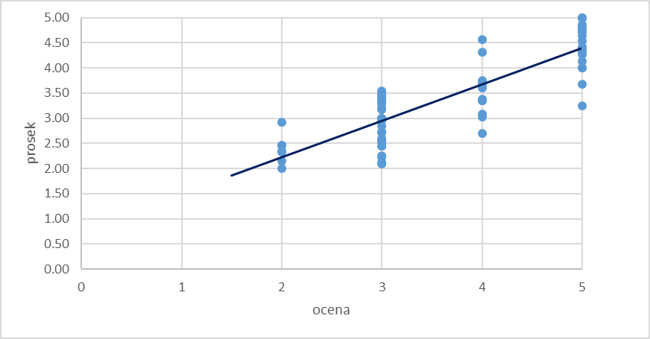
Data analysis showed that in 70.83% of students (51 students) in the sample, the success of students coincides with the grade in informatics (a measure of digital competence in work), while in 29.17% (21 students) there is a deviation of success from the grade in informatics. When we present these deviations graphically, it can be seen that in as many as 25% of students the school success is lower than the grade in informatics and only three students have higher school success than the grade in informatics.

Slide 10
The research checked whether there is a dependence of students' school success on the development of their digital competencies by calculating the correlation coefficient. Based on the obtained value of the correlation coefficient and the interval to which it belongs, a conclusion was made about the connection between school success and digital competencies. Based on the collected data and their processing, the value of the correlation coefficient (Pearson's coefficient) of 0.854 (r) was obtained.
This research proved the hypothesis "There is a linear correlation between digital competencies of students and student achievement in school" to be correct based on the obtained correlation coefficient of 0.854 which corresponds to the interval of excellent correlation, which means that student success directly depends on digital competencies and 72.93% ( obtained using the coefficient of determination) depends on the digital literacy of students, while other phenomena (motivation, time spent in learning, way of presenting teaching content, readiness of teachers to help students in case of difficulties) with 27.06% affect student success in school.

Slide 11
Conclusion
The development of digital literacy within formal education should be viewed strategically and as a whole, individual steps should be combined into one project that needs to be gradually implemented in order to reach an adequate practice of developing digital literacy. It is necessary to start systematically, from the level of educational policy; regulations and other legal documents to regulate the obligation, but also the manner of introduction and implementation of the practice of developing digital literacy among students; formulate goals and concretize tasks; provide appropriate opportunities for professional development of teachers in the field of digital technologies; and provide appropriate and necessary technical and other conditions for the development of digital literacy in students.
Teachers also need to change their way of working in order to achieve teaching efficiency, to form a positive attitude towards integrating technology into teaching and to adopt a model of e-learning that causes students to be more motivated to learn and maintain attention to the teaching material.

