Slide 1
D. Banović, and Z. Kazi
University of Novi Sad,
Technical faculty “Mihajlo Pupin”,
Zrenjanin,, Republic of Serbia
dragana.banovic@tfzr.rs; zoltan.kazi@tfzr.rs
CSS
Electronic Application of Children for Enrollment in Preschool Institution
PHP

Slide 2
This paper describes a novel system for the electronic application of children for enrollment in preschool institutions in Serbia.
This problem is elaborated through system description, structural system analysis, data modeling, object data modeling and object – oriented programming software.

Slide 3
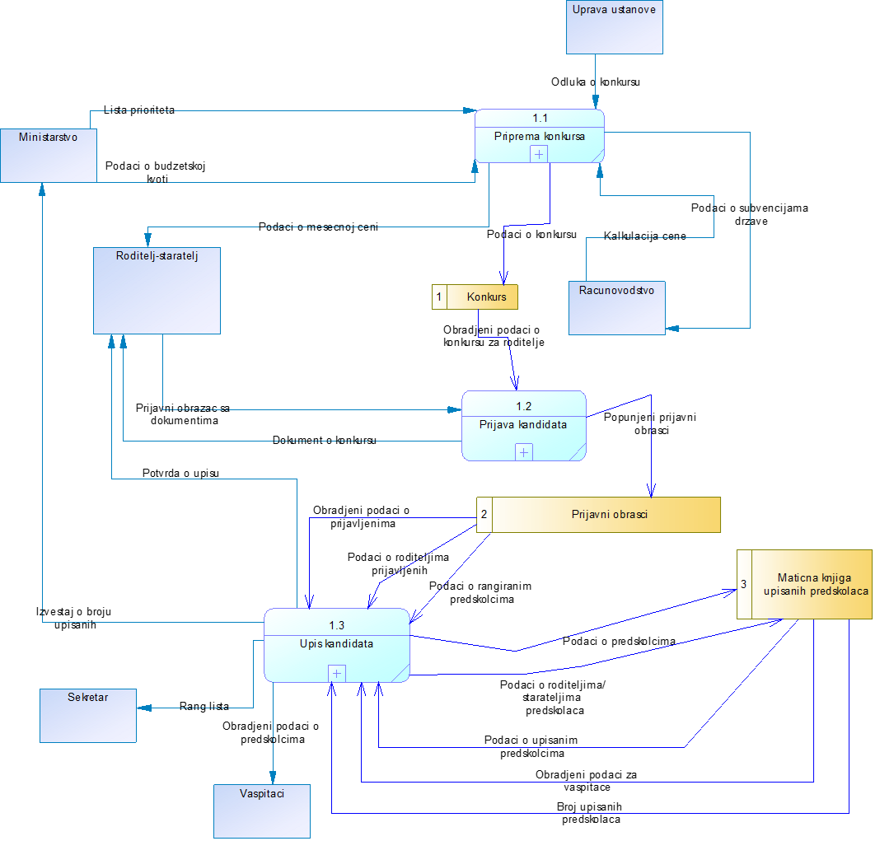
ENROLLMENT BUSINESS PROCESS
The business processes model - diagram with entities, data flows, processes and data stores

Slide 4
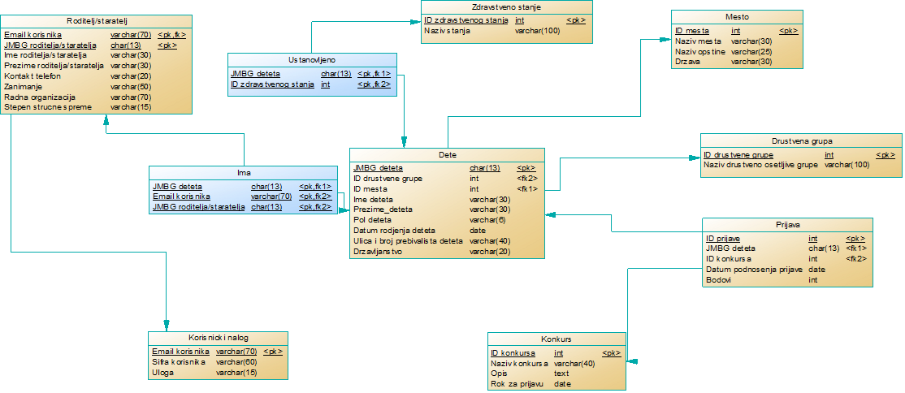
CONCEPTUAL DATA MODEL
CDM contains entities with attributes and their domains, data types, constraints, relationships between entities.

Slide 5
SYSTEM DESCRIPTION – HOME PAGE
When starting the home page, there are the following functions:
child's log in,
a contest preview where the contest can be selected from the drop-down menu,
login and user registration.
On the home page there is also an "advertisement" for the registration of children which displays a message to the user on how to log in and how to register the child.
There is also information about the application.

Slide 6
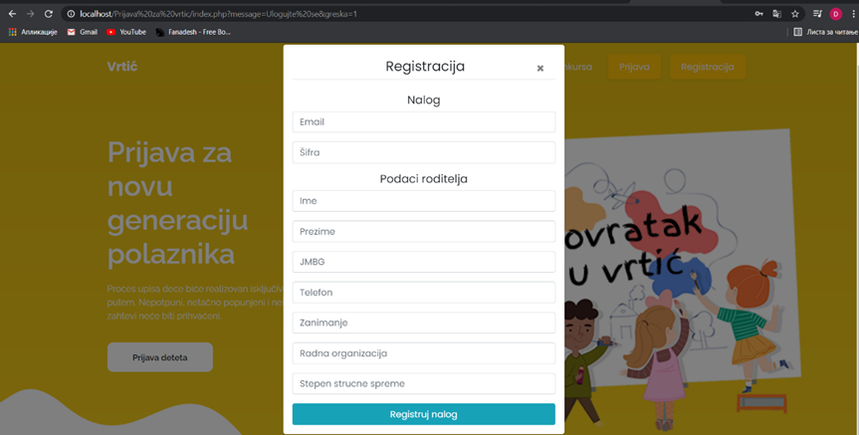
SYSTEM DESCRIPTION – USER LOGIN AND REGISTRATION
User registration form
User login requires entering the user's email address and password and the ability to register if the user has not created a user account. The parent registration form has been implemented in the same way.
A parent cannot create an account unless they enter their personal information. All registered users are considered parents, while the administrator is entered directly into the database in the user account table without the need to register.

Slide 7
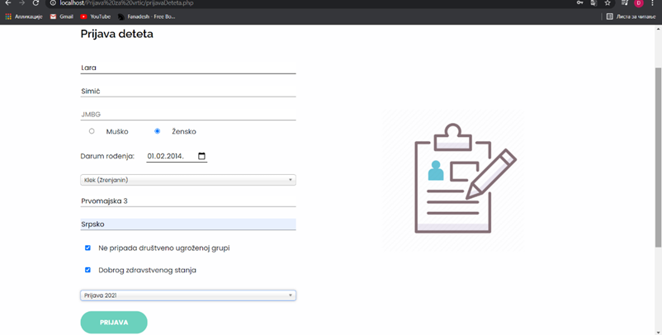
SYSTEM DESCRIPTION – APPLICATION FORM
Application form
Only users who are registered as parents can register a child.
Data on the socially sensitive group or endangered health condition of the child are priorities when ranking, because based on that, these children receive points.
After selecting the "apply" button, the child is entered into the database and a confirmation of the success is sent to the user. It is important to mention that parents cannot apply for a child for a competition that has expired, ie whose deadline has passed.

Slide 8
SYSTEM DESCRIPTION – SEARCH OF DATA
The search of data was realized using the JavaScript function. Users must enter part of the name or full name in the search field.
There is also a software function that allows you to view all data.
If a user wants to delete data, a confirmation message appears stating whether users are sure or not to delete data after confirmation. After confirmation data will be deleted from the database with a message about the successful operation.

Slide 9
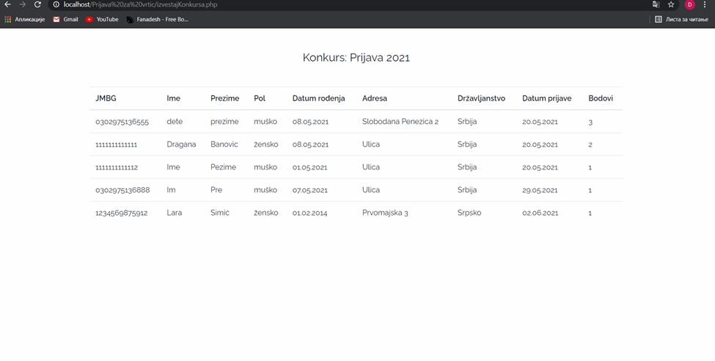
SYSTEM DESCRIPTION - REPORTS
Report preview
Within the web application, there is a possibility for creating two types of reports:
report for the applicants for the competition with points
report for the registered child

Slide 10
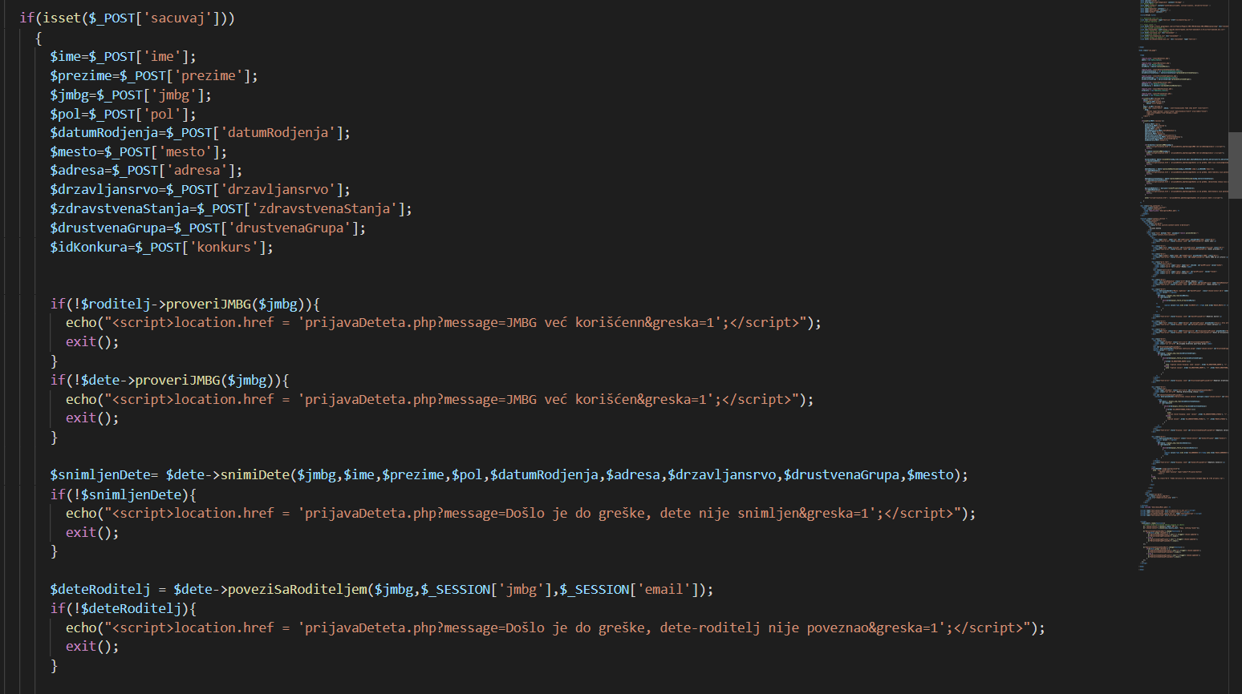
IMPLEMENTATION
This application is implemented with an object-oriented approach, which involves working with classes, objects, attributes and methods. Attributes are created based on the columns of the database table, and the methods are used for implementation.
The content of the home page is formed by the Bootstrap framework, using the section classes in the central part of the page. The site consists of HTML tags and links to CSS and JavaScript files.
PHP programming language commands
Methods are implemented within classes and use the SQL DML commands.

Slide 11
POSSIBILITY OF UPGRADING THE SOFTWARE
The possibility of upgrading the software is provided by the structural system analysis, which contains other tasks performed during the enrollment of children, such as calculating the price, opening the child's registry, issuing a certificate of enrollment, sending reports to the ministry and the like.

Slide 12
THANK YOU
FOR YOUR ATTENTION!
dragana.banovic@tfzr.rs
zoltan.kazi@tfzr.rs

