Slide 1
VEHICLE ROUTING PROBLEM WITH DISTANCE CONSTRAINTS AND CLUSTERING
USING MATLAB
Dejan Krstev*, Sasko Dimitriev*, Aleksandar Krstev**
* Faculty of Mechanical Engineering, University Goce Delcev – Shtip
** Faculty of Computer Science, University Goce Delcev – Shtip

Slide 2
Abstract
The problem of designing routes for vehicles that should supply different customers with defined locations and specific demand from a single or various depots is known as the vehicle routing problem. The main objective in this case is minimizing the total cost of delivery or maximizing the profit while taking into consideration some constraints that vary from a case to another. In this paper I am going to define this problem, present a mathematical model to describe it, talk about the existing solutions to solve it, and use different tools to solve a real VRP of a company in tangier.

Slide 3
Vehicle Routing Problem (VRP)
Table 1. Distance between cities in Eastern Macedonia
 | 1 | 2 | 3 | 4 | 5 | 6 | 7
1 |  | 39 | 99 | 50 | 91 | 168 | 154
2 | 39 |  | 60 | 55 | 66 | 145 | 131
3 | 99 | 60 |  | 116 | 52 | 151 | 156
4 | 50 | 55 | 116 |  | 40 | 109 | 113
5 | 91 | 66 | 52 | 40 |  | 83 | 66
6 | 168 | 145 | 151 | 109 | 83 |  | 85
7 | 154 | 131 | 156 | 113 | 66 | 85

Slide 4
Vehicle routing problem for Eastern part of North Macedonia
Further we will consider the route from (7) Strumica to (5) Stip. If they are neighbors on the route it would be desirable to connect 6 → 7 → 5 or 5 → 7 → 6. The total number of units which is 4 700 in this route does not exceed the capacity of the vehicle (5000) Since the transported 4 700 units so far reach the capacity of the vehicles, the route of the first vehicle is completed
We will review the route of the second vehicle in the nodes (3) Kriva Palanka and (2) Kumanovo. They can be presented in the same route because the required units for delivery are 1,400 and 900, ie 2,300 units, which fills the capacity of 5,000 units

Slide 5
Vehicle routing problem for Western part of North Macedonia
The next route with the greatest distance saving is (8) Prilep to (9) Bitola, if they are neighbors in the route it would be desirable to connect 10 → 9 → 8 → 11 or 11 → 8 → 9 → 10. As the 6,800 units transported so far approach the capacity of the first vehicle (7,000 units), the route of the first vehicle is completed.
The next route is (12) Gostivar and (14) Kicevo, which can be connected to the previous route 12 → 13, thus obtaining the desired route 13 → 12 → 14 or 14 → 12 → 13 with 4,000 units.

Slide 6
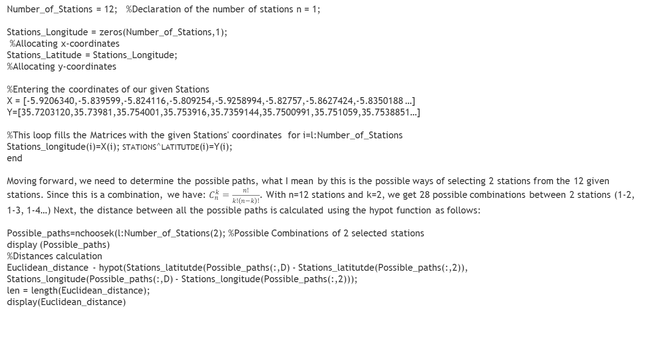
  STEPS OF THE IMPLEMENTATION PROCESS
Number_of_Stations = 12; %Declaration of the number of stations n = 1;
Stations_Longitude = zeros(Number_of_Stations,1);
%Allocating x-coordinates
Stations_Latitude = Stations_Longitude;
%Allocating y-coordinates
%Entering the coordinates of our given Stations
X = [-5.9206340,-5.839599,-5.824116,-5.809254,-5.9258994,-5.82757,-5.8627424,-5.8350188 …]
Y=[35.7203120,35.73981,35.754001,35.753916,35.7359144,35.7500991,35.751059,35.7538851…]
%This loop fills the Matrices with the given Stations' coordinates for i=l:Number_of_Stations
Stations_longitude(i)=X(i); stations^latitutde(i)=Y(i);
end
Moving forward, we need to determine the possible paths, what I mean by this is the possible ways of selecting 2 stations from the 12 given stations. Since this is a combination, we have: $C_{n}^{k}=\frac{n!}{k!\left(n−k\right)!}$. With n=12 stations and k=2, we get 28 possible combinations between 2 stations (1-2, 1-3, 1-4…) Next, the distance between all the possible paths is calculated using the hypot function as follows:
Possible_paths=nchoosek(l:Number_of_Stations(2); %Possible Combinations of 2 selected stations
display (Possible_paths)
%Distances calculation
Euclidean_distance - hypot(Stations_latitutde(Possible_paths(:,D) - Stations_latitutde(Possible_paths(:,2)),
Stations_longitude(Possible_paths(:,D) - Stations_longitude(Possible_paths(:,2)));
len = length(Euclidean_distance);
display(Euclidean_distance)

Slide 7
RESULTS AND CONCLUSION
The total length of the optimal route generated and with the following route in order:
Looking at the solutions for routing the vehicle in Eastern Macedonia I can create a complete tour 1 → 2 → 4 → 5 → 7 → 6 → 3 → 1 whose length is 535 km. Since this method does not always give the optimal value of the tour, I reviewed the network again with the help of a software tool and found a better tour, such as 1 → 4 → 6 → 7 → 5 → 3 → 2 → 1. The total distance of this tour is 461 km, compared to the previous one of 535 km, or a difference of 48 km.
Looking at the solutions for routing the vehicle in Western Macedonia I can create a complete tour 1 → 13 → 12 → 14 → 10 → 9 → 8 → 11 → 1 whose length is 479 km. Since this method does not always give the optimal tour value, I reviewed the network again and found a better tour, such as 1 → 13 → 12 → 14 → 10 → 9 → 11 → 8 → 1. The total distance of this tour is 456 km, compared to the previous one of 479 km, or a difference of 23 km

