Slide 1
﻿Importance of Learning SOA in Modern GIS Lectures
﻿Dubravka Sladić*, Aleksandra Radulović*, Miroslav Zarić* and Branko Markoski**
* University of Novi Sad, Faculty of Technical Sciences, Novi Sad, Serbia
** University of Novi Sad/Technical Faculty Mihajlo Pupin, Zrenjanin, Serbia
{dudab, sanjica, miroslavzaric, markoni}@uns.ac.rs
INTERNATIONAL CONFERENCE "INFORMATION TECHNOLOGY AND EDUCATION DEVELOPMENT" - ITRO 2021

Slide 2
Introduction
Dissemination of geospatial data has large importance in promoting its use to the wider audience rather than the narrow group of experts.
Geospatial data is acquired through various surveying techniques and technologies such as GNSS, LiDAR, remote sensing, photogrammetry, etc.
Modern Web technologies are used to promote its use and make it publicly available.
To bridge the communication gap between the two group of domain experts (geospatial and web) it is necessary to develop a methodology which will connect these two areas.
The aim is to demonstrate a theoretical framework and a stack of technologies necessary to adopt the basic concepts of web development domain in the field of geoinformatics and AEC in general.
The case study is demonstrated on the student project performed in the curriculum at the Master studies of Geodesy and Geoinformatics, University of Novi Sad.

Slide 3
The role of Service Oriented Architecture in geopsatial domain
Service Oriented Architecture (SOA) is a distributed computing architecture based on weakly coupled service interactions in which a service interaction model shows the interaction between different agents for publishing, finding, and invoking services.
This model is also called the publish-find-bind model.

Slide 4
Geospatial RESTful Web services
Geospatial services are RESTful Web services that implement OGC standards for the service interface.
Representational State Transfer (REST) is a software architecture for distributed systems such as the WWW.
Although the WSDL standard is intended for Web service specification, REST has taken a leading role in the field of geoinformation, so the OGC consortium has adopted it as the basis for developing OGC specifications.
RESTful services are based on the HTTP protocol and use HTTP methods such as GET and POST to send client requests to the server in a client-server architecture.

Slide 5
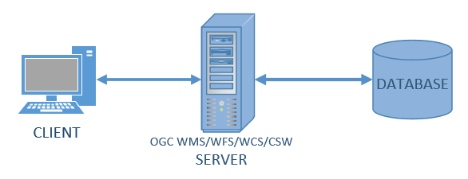
Three-tier architecture
Data tier - contains data in a database or file system.
Service tier - implements services that mediate between the data tier and the application tier, by accessing the data tier at the user's request, downloading data, processing (in the form of map rendering, data filtering, coordinate transformation, etc.) and delivering the result to the end user.
Application tier - a set of applications that access services. These applications can run in a web browser (so-called thin client) or can be desktop applications (so-called thick client) that have support for standard interfaces.

Slide 6
SOA, SDI and INSPIRE
SDI is defined as a framework of policies, institutional arrangements, technologies, data, and people that enables the sharing and effective usage of geospatial information by standardizing formats and protocols for access and interoperability.
SDI services are part of a distributed system based on SOA.
INSPIRE (INfrastructure for SPatial Information Information in Europe initiative) is an initiative launched, developed, and adopted as a directive by the European Union on 14 March 2007, in cooperation with Member States and associated countries.
The purpose of the directive is to define the basic rules aimed at establishing the Spatial Information Infrastructure in the European Union for the needs of Community environmental policies and the needs of policies and activities that may have an impact on the environment

Slide 7
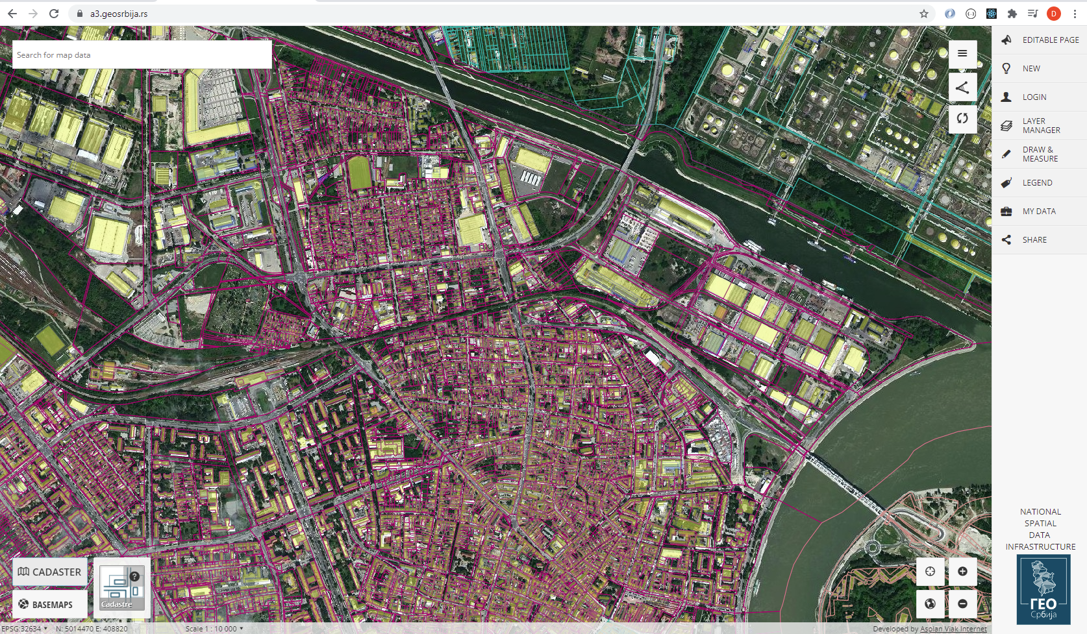
NSDI GeoSrbija
The national geospatial data infrastructure is the connection and exchange of harmonized data from different sources from different data owners that are easily accessible to users via the Internet.
The NSDI components include geospatial data, metadata, services, standards and the institutional framework, i.e. the basic SDI components.
NSDI follows the three basic pillars of INSPIRE: metadata, information models for geospatial data and network services based on the principles of SOA.

Slide 8
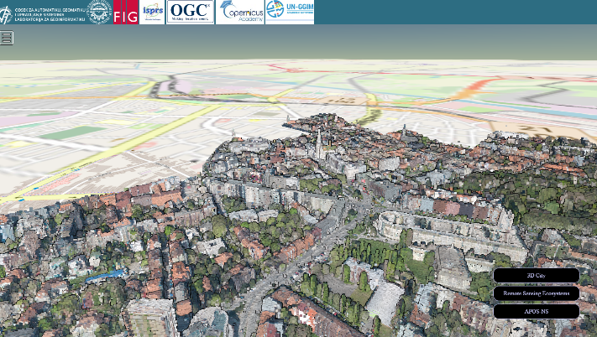
Implementation Technologies
Technical implementation of NSDI is realized using web development technologies.
Front-end web development deals with that part of the site or web application that is displayed in the web browser.
HTML, CSS, JavaScript, JavaScript libraries and frameworks
Back-end web development deals with the business logic that runs on the server and communicates directly with the database, while giving the client side an interface to access that data.
Java, .Net, Python, Spring Boot, relational databases and SQL, object relational mapping such as Java Persistence API (JPA), etc.
JavaScript libraries and frameworks
DOM/UI | 2D Geospatial | 3D visualisation
jQuery Bootsrap Angular React Vue ... | OpenLayers GoogleMaps Here maps Leaflet ... | D3.js HighCharts Three.js Babylon.js A-frame Cesium ...
3D point cloud for the city of Novi Sad
Geoinformatika, http://geoinformatika.uns.ac.rs/

Slide 9
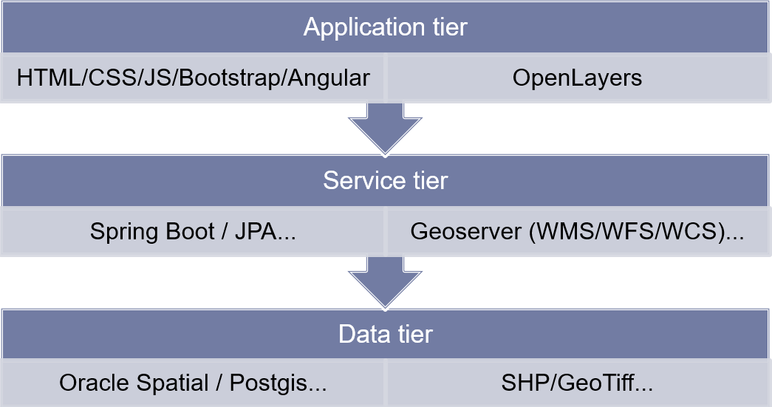
A4GEO student project
A4GEO geoportal is implemented as a student project in the course called Geoportals and Geospatial Services at Master studies of Geodesy and Geoinformatics, Faculty of Technical Sciences, University of Novi Sad.
The implementation is based on three-tier architecture.

Slide 10
A4GEO Back-end development and Rest services
A4GEO project uses two different solutions for the back-end development.
Geoserver – geospatial data
Spring Boot – alphanumeric data
To access and visualize geospatial data of cadastral maps an open-source solution GeoServer is used. It is used to deliver geospatial data through WMS and WFS interface.
GeoServer is an open-source server for exchanging geospatial data which publishes data from all important spatial data sources using open standards. It supports OGC WMS, WFS, WCS open standards. Its main goal is interoperability.
Alphanumeric data is accessed through Rest services developed in Spring Boot environment.

Slide 11
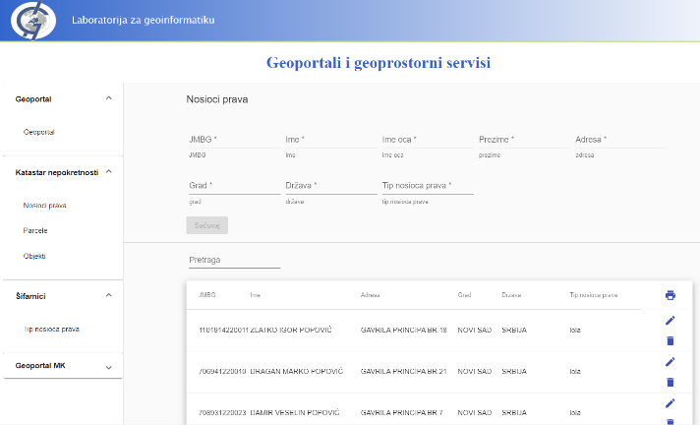
A4GEO Frontend
A4GEO frontend is developed in an Angular framework.
Angular Material consists of a set of components that implement common patterns of user interaction according to the Material Design specification. It consists of the common graphical user interface elements such as menu, button, table, data entry forms, etc.

Slide 12
A4GEO Frontend – geoportal
Geoportal is realized using OpenLayers an open-source JavaScript library for working with geospatial data.
OpenLayers can display raster maps, vector data and markers loaded from any source.
It was developed with the aim of promoting the use of geospatial information of all kinds.
It uses Geoserver as a backend to retrieve and display data in OGC WMS, WFS and WCS format.

Slide 13
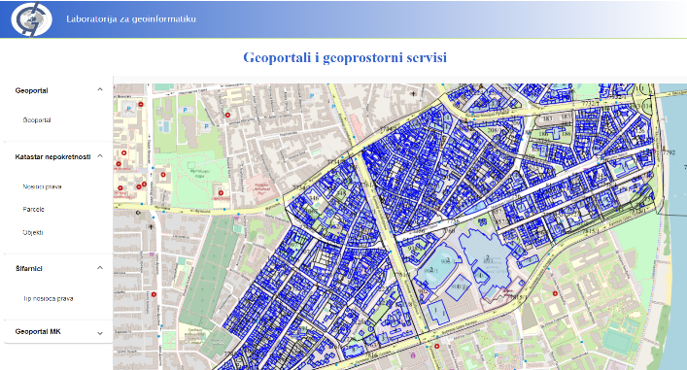
A4GEO Frontend – geoportal
Cadastral map data on the developed geoportal as part of A4GEO web application.
OpenLayers library can be easily installed and integrated in the project.
npm install ol
Proj4js JavaScript library that supports all the coordinate systems and projections including coordinate system and projection for Serbia (EPSG: 32634 - WGS 84 / UTM zone 34N - Serbia).
npm install proj4

Slide 14
Conclusion
The paper described the basic theoretical concepts and practical work related to the field of SDI and geoportals and geospatial services that is used in education.
The experience gained through the years of implementation of this curriculum showed the good results in increasing awareness of geospatial data sharing and technologies that enable this.
Although, experts and students in the field of geodesy and geoinformatics are not familiar and prone to programming and informatics in general, acceptance of the newly gained knowledge and skills showed excellent results not only in studies, but in further professional career, too.

Slide 15
Thank you for your attention!

